Slide 1
Detecting Land Cover Coastline Change in Cedar Key, Florida
Melissa Moreno
April 20, 2019

Slide 2
Statement of the Problem
- Big Bend coast is protected but shoreline lost is not being monitored
- Cited as an area to be conserved and investigated by the State of Florida
- Locals and agencies interested in changes to the area in the last few decades

Slide 3
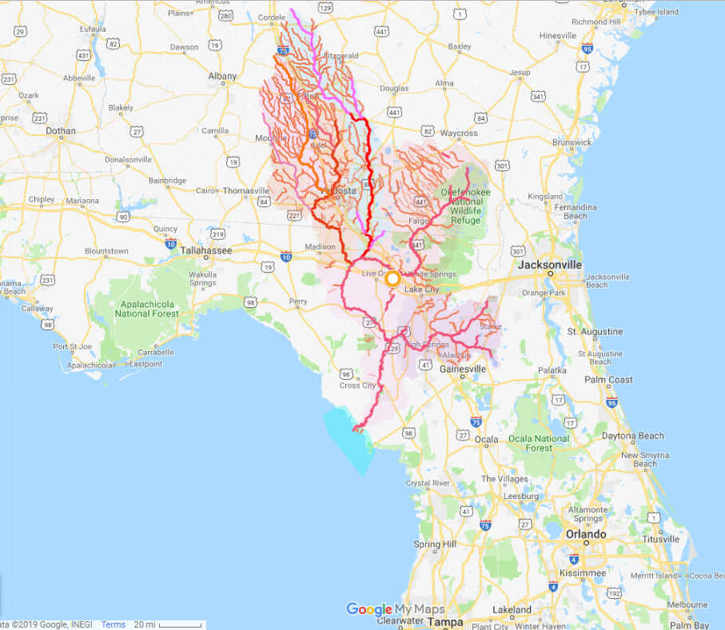
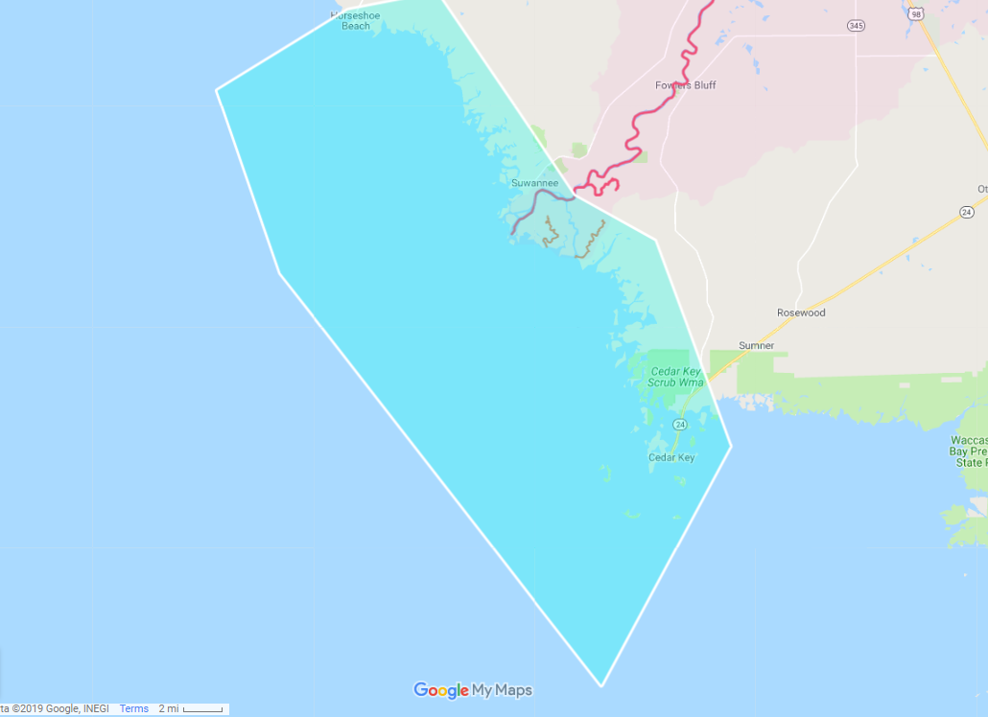
Study Area
Figure 1- Google map displaying Suwannee River basin in Georgia and Florida. The basin ends in the Suwannee Sound, (turquoise area). Provided by WWALS Watershed Coalition (Suwannee RIVERKEEPER®, http://wwals.net/2017/11/14/suwannee-river-basin-maps/#basingooglemap). The Suwannee River exits on the west coast of Florida (bolded pink line). Whole area (top), actual study area(bottom)

Slide 4
Methods Using ENVI
1. From the Toolbox, select Change Detection > Change Detection Statistics.
The Select the ‘Initial State’ Image dialog appears.
2. Select a classification image representing the initial state and perform optional spatial subsetting, then click OK. The Select the ‘Final State’ Image dialog appears.
3. Select a classification image representing the final state and perform optional spatial subsetting, then click OK. The Define Equivalent Classes dialog appears.
4. Match the classes from the Initial and final state images by selecting the matching names in the two lists and clicking Add Pair.
Add only the classes you wish to include in the change detection analysis (you do not have to pair all classes). The class combinations are shown in a list at the bottom of the dialog. If the classes in each image have the same names, they are automatically paired.
5. Click OK. The Change Detection Statistics Output dialog appears.
6. Select the Report Type. You may choose any combination of Pixels, Percent, and Area.
7. Click the Output Classification Mask Images? toggle button to specify whether or not to create class masks.
8. If the Output Classification Mask Images? toggle button is Yes, select output to File or Memory.
9. Click OK. If an Area Report was requested but the initial state image does not have pixel sizes defined, the Define Pixel Sizes for Area Statistics dialog displays.
10. Enter the pixel sizes.
11. Click OK. ENVI adds the resulting output to the Layer Manager and opens the statistics in the Change Detection Statistics window.
https://www.harrisgeospatial.com/docs/ChangeDetectionAnalysis.html#Computin

Slide 5
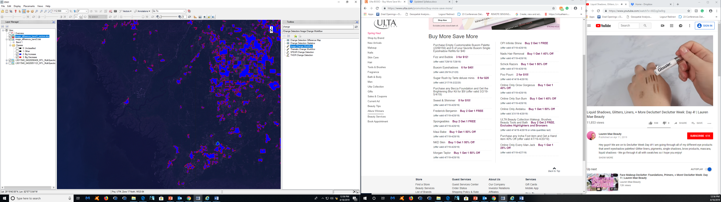
Results
Increase (blue) and Decrease (red) in vegetation
Detectable differences in map for both increases and decreases
The differences are in clusters
Not near the shore, closer to towns and cities
Band 3 Increase is blue, decrease is red, overlaid on the 2009 map (which is the latest image)

Slide 6
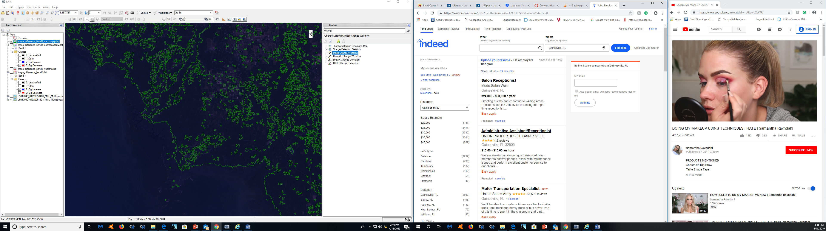
Results
Decrease only analysis
All shoreline is affected
Biomass content has also changed around the shoreline and also near towns and cities
A lot of the area of the map band is affected
“Decrease Only” in Band 4, same paraments as Band 3, overlaid on the 2009 map (which is the latest image)

Slide 7
Conclusions
- Good first step of analyzing what has changed in the study area for my Master’s thesis
- Will require more imagery and data to have a clear understanding of coastline changes over the years

